Slide 1



Industrial Training
On
A Practical Understanding of Software Quality Assurance
Green University of Bangladesh
Department of Computer Science and Engineering
Software Testing & Quality Assurance
CSE-458

Slide 2
PRESENTED BY:
ACADEMIC SUPERVISOR
INDUSTRY MENTOR
MD. Abu Rumman Refat
Masudur Rahaman
Sajid Rahman Rifan
212902017
02

Slide 3

TABLE OF CONTENT
Introduction
Motivation
Scheduling
SQA Methodologies
Objectives
Organization Details
Scope of Future Work
Conclusion
Tools and Techniques
Challenges
Types of Test We Performed
03

Slide 4

Introduction
Internship Overview: The internship at QA Harbors Limited focused on Software Quality Assurance (SQA), offering practical exposure to software testing tools, methodologies, and quality assurance processes.
Key Outcomes: The experience bridged the gap between academic knowledge and professional practice, improving technical proficiency in SQA tools and techniques while fostering a deeper understanding of the critical role SQA plays in delivering high-quality software products. now more less
04

Slide 5

Motivation
🚀 Desire to bridge academic knowledge with real-world experience
💡 Curiosity to explore practical tools and testing frameworks
🎯 Determination to overcome self-doubt and build confidence
📈 Passion for learning and professional growth
👨‍💻 Interest in contributing to real software quality projects
05

Slide 6

Practical Experience.
Understanding Frameworks.
Skill Development.
Professional Exposure.
Personal Growth.
06

Slide 7
Organization Details
Name: QA Harbor Limited
Experts in software quality assurance.
Motto: Quality As A Service (QAAS)
Mission: Deliver superior, error-free solutions globally.
Vision: Achieve client satisfaction through innovation and continuous improvement.
Services: Testing (Manual, Automated, Security, Performance), QA Consulting, Team Augmentation.
Approach: Agile workflows, advanced tools, and dedicated teams for seamless collaboration.
07

Slide 8
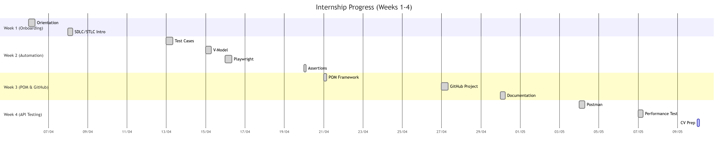
Scheduling
Week 1: Covered the basics of software testing, testing principles, and test management.
Week 2: Focused on Playwright automation tool and learning its advanced features.
Week 3: Emphasized API testing using tools like Postman, and explored SOAP/REST services.
Week 4: Deep-dived into Playwright with Page Object Model (POM) and began performance testing including load testing.
08

Slide 9

SQA Methodologies
Software Testing Life Cycle (STLC)
V-Model Approach
Agile Methodology
09

Slide 10

SQA Methodologies Cont...
Software Testing Life Cycle
The Software Testing Life Cycle (STLC) is a subset of SDLC that focuses specifically on the testing phases to ensure quality throughout development.
10

Slide 11
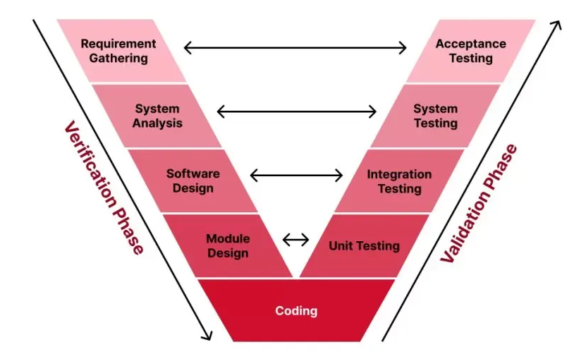
SQA Methodologies Cont...
V-Model Process
The V-Model (Verification and Validation) is a development methodology where each development stage corresponds to a testing phase.
11

Slide 12
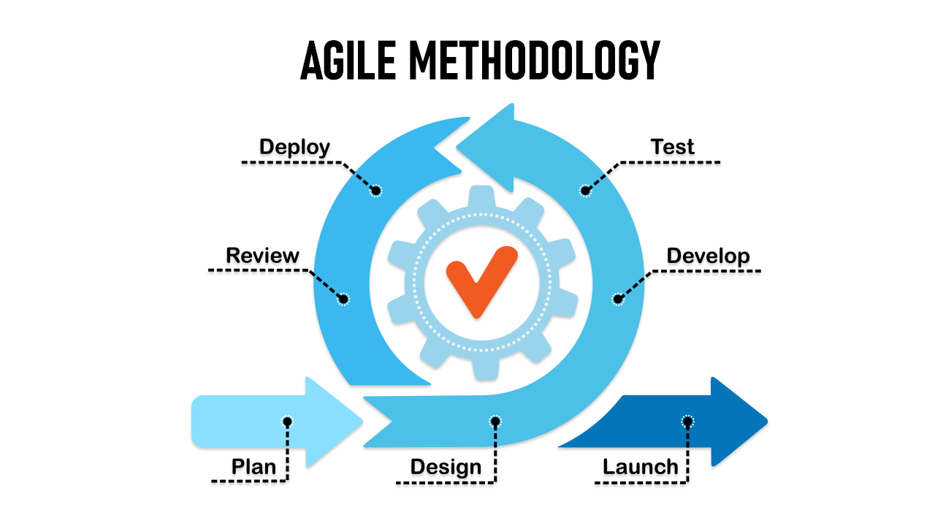
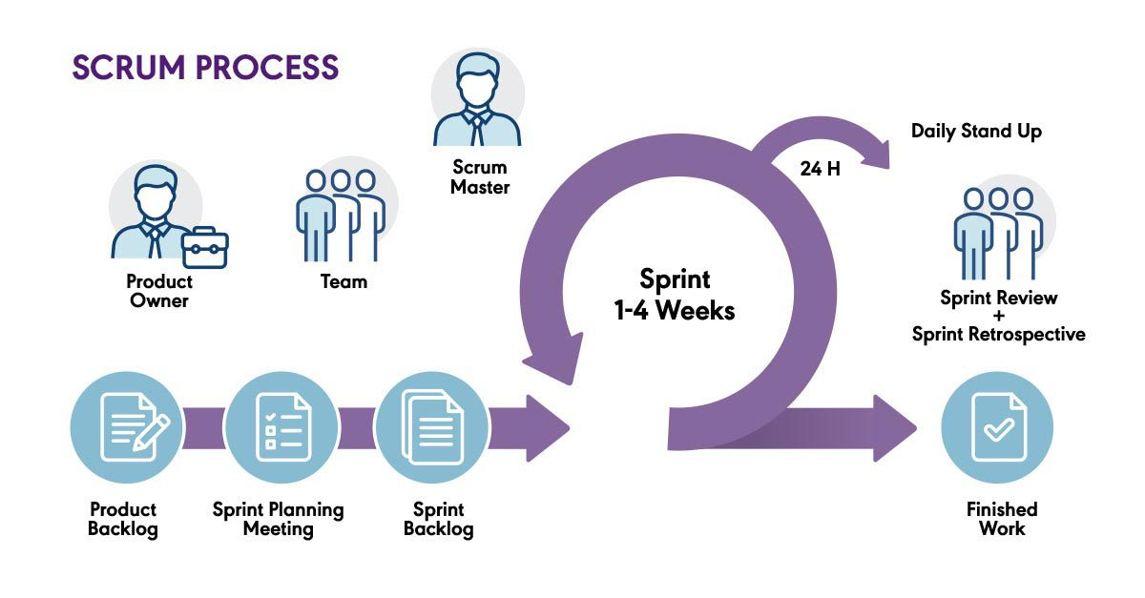
SQA Methodologies Cont...
Agile Methodology​
Agile Frameworks
1.Scrum
2.Extreme Programming (XP)
3.Lean
12

Slide 13





Tools and Techniques
13

Slide 14
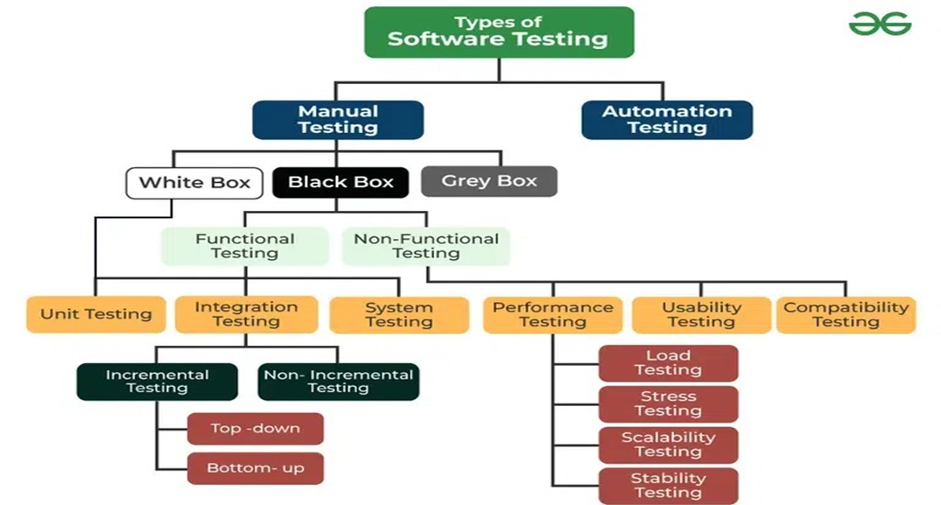
Types of Testing
14

Slide 15

Types of Test We Performed
Manual Test.
Automation Test.
Security Test.
Performance Test:
Load Testing.
Stress Testing.
15

Slide 16
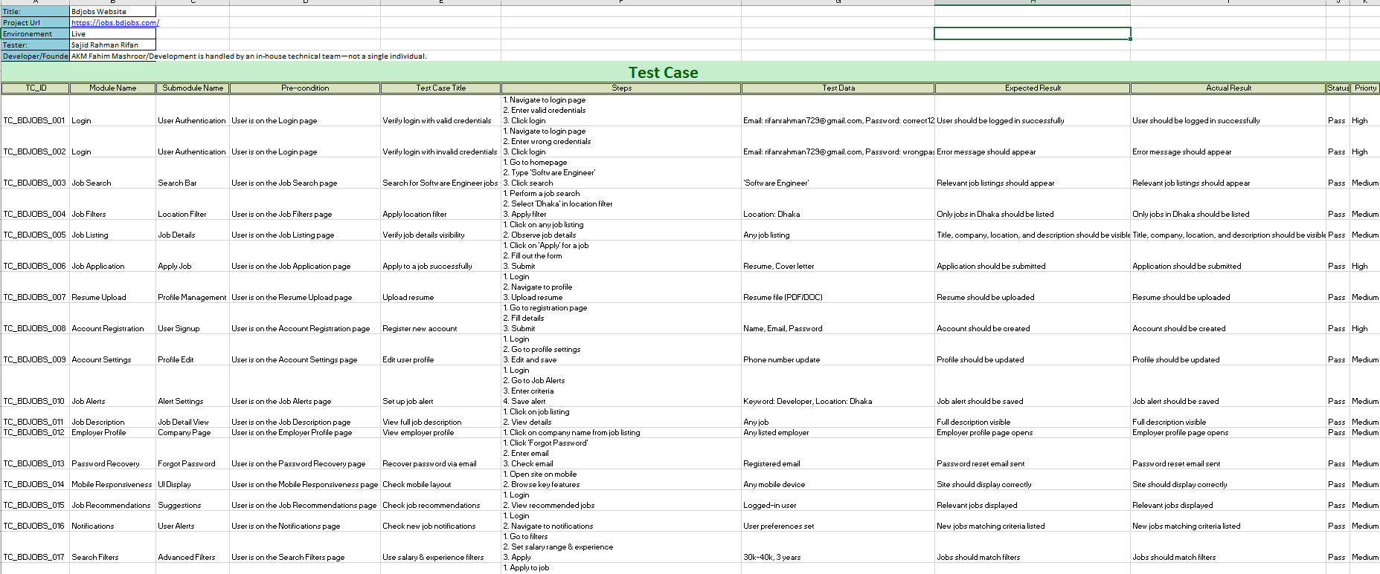

Manual Test Case (Bdjob’s Website)
Manual Test Case
16

Slide 17
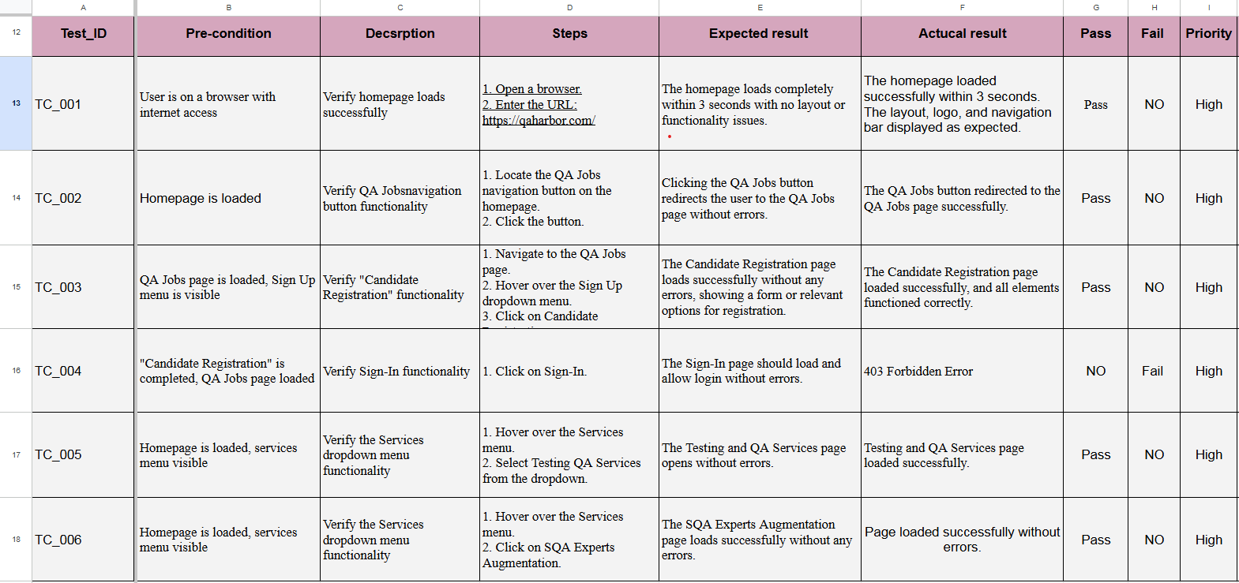
Manual Test Case (QA Harbor Website)
Manual Test Case
17

Slide 18
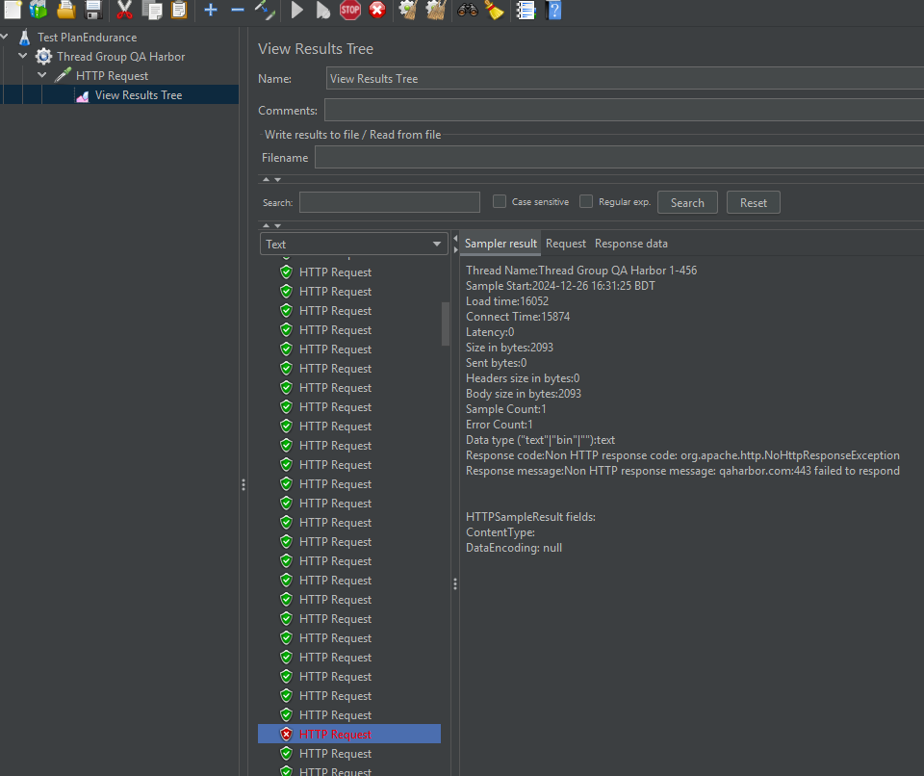
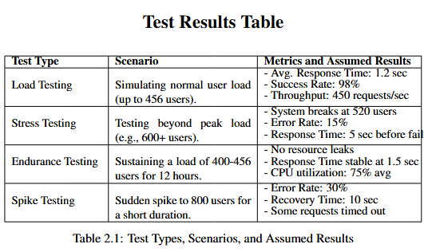
Performance Test(QA Harbor Website)
18

Slide 19
My Project on
Playwright Test for Bdjob’s Website
Automation Test
19

Slide 20
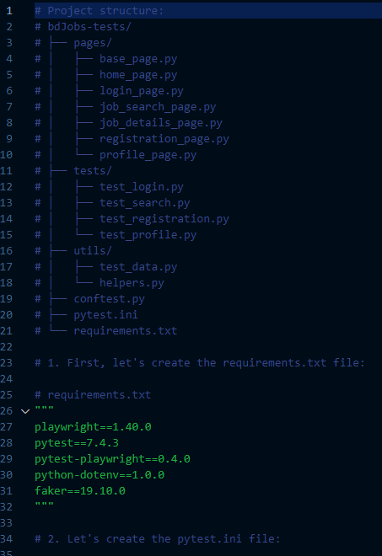
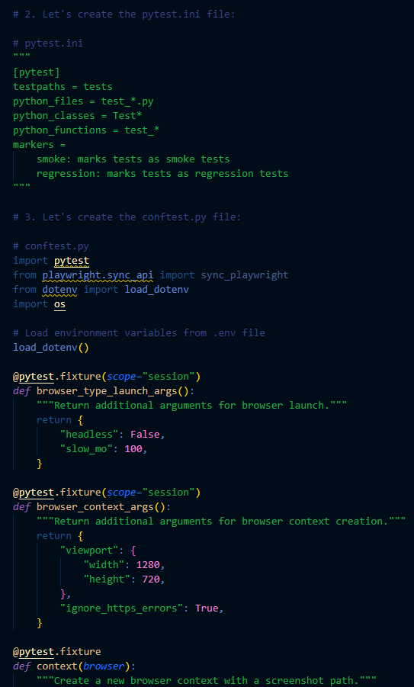
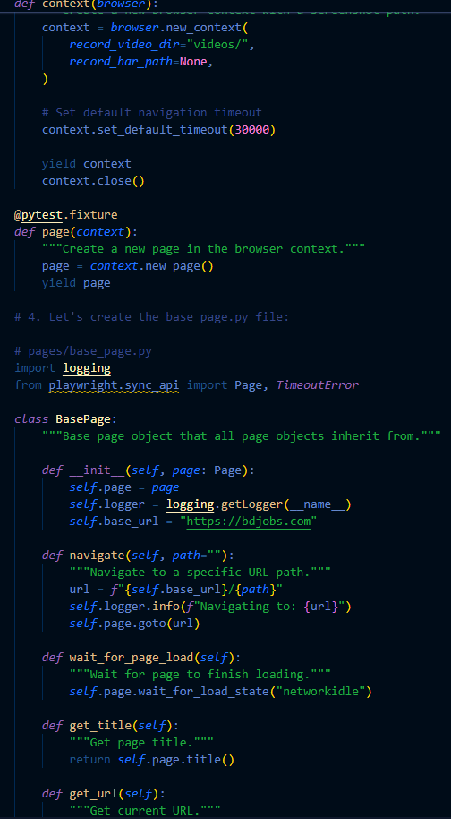
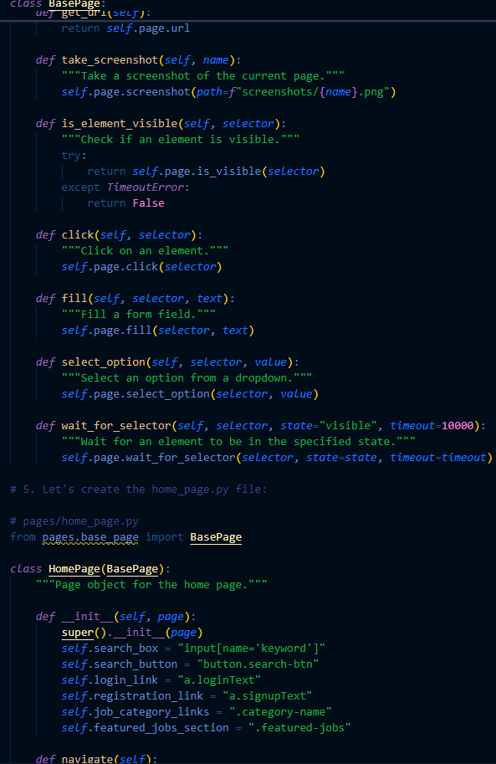
Playwright Test for Bdjob’s Website
20
Automation Test

Slide 21
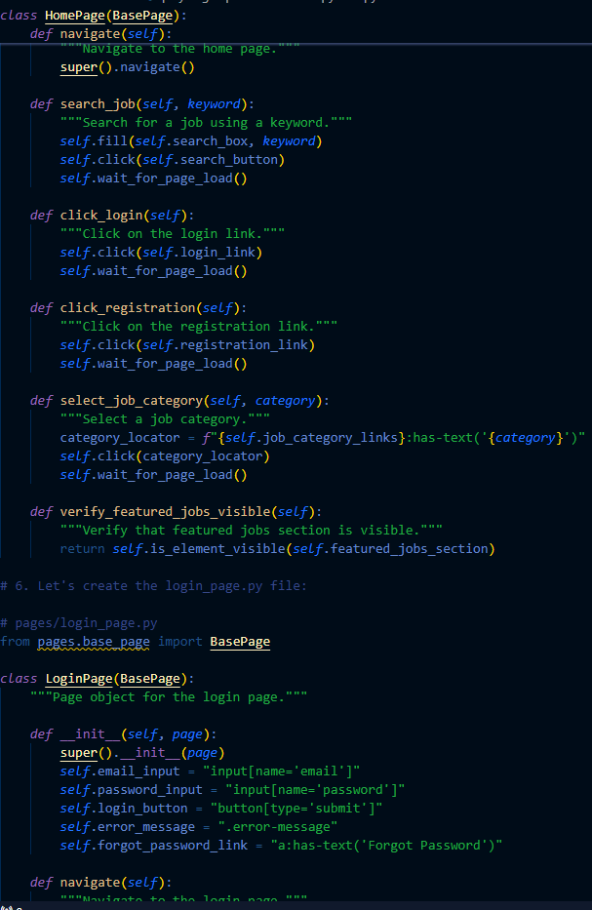
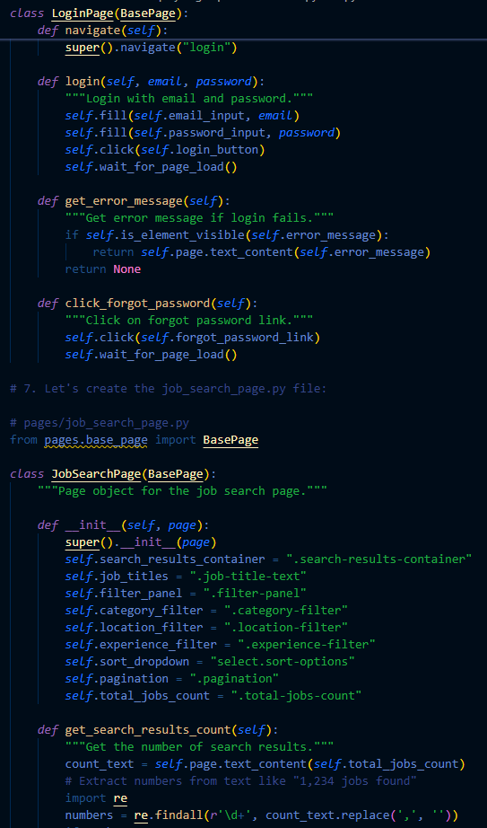
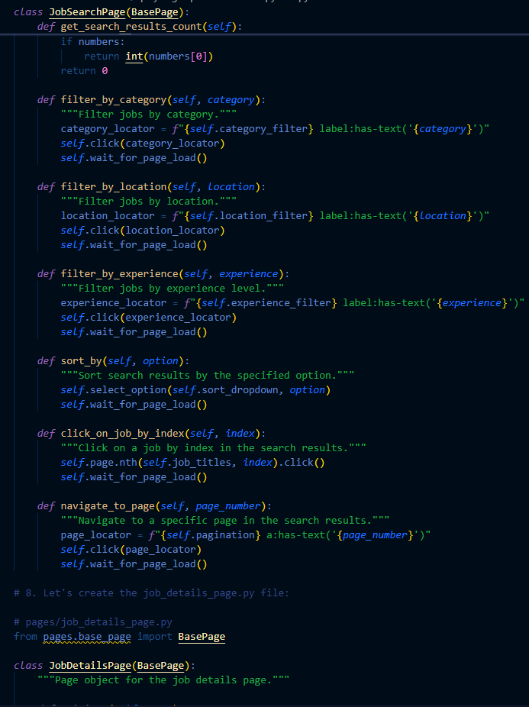
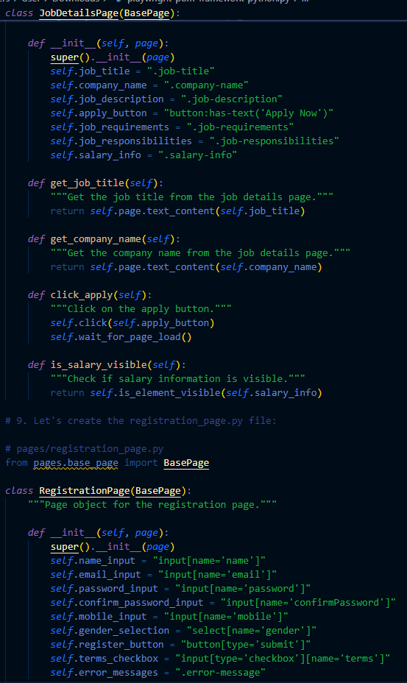
Playwright Test for Bdjob’s Website
21
Automation Test

Slide 22
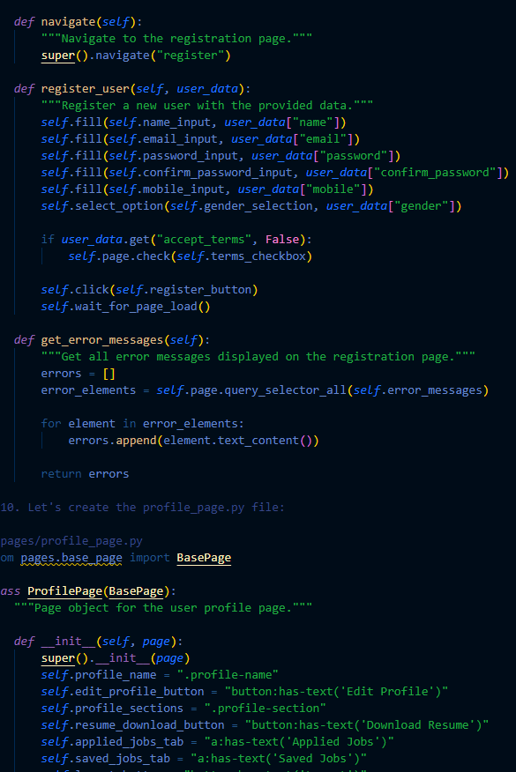
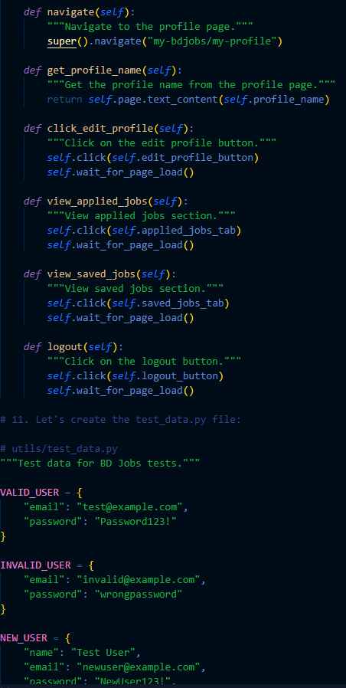
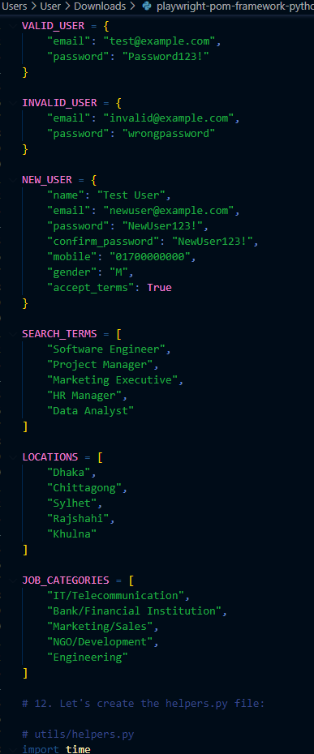
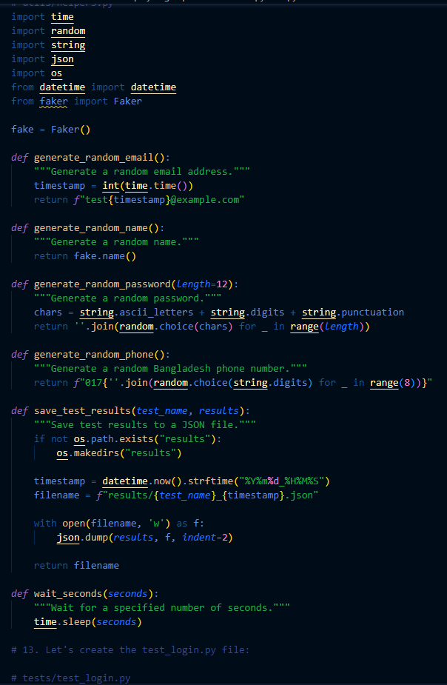
Playwright Test for Bdjob’s Website
22
Automation Test

Slide 23

Scope of Future Work
The following things have to be integrated to bring out the best output for the software testing field.
Security Testing
23

Slide 24


I completed my industrial training based on software testing field at QA Harbor Limited which is located at Mohakhali, Dhaka. During my industrial training I have explore various kinds of testing. So, I believe that this 4 weeks training will enhance my technical skills and build my future as well.
24

Slide 25

End

